Slide 1
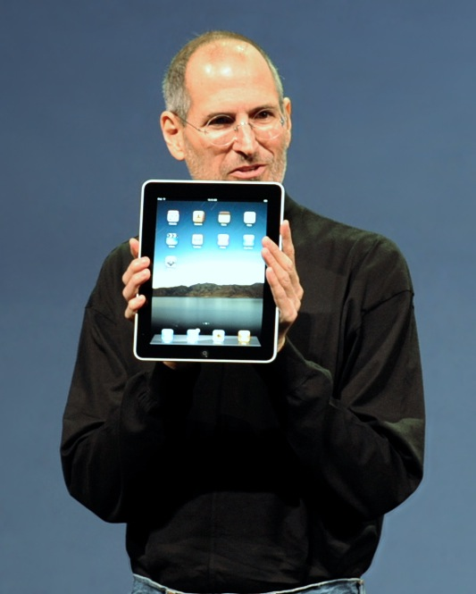
Cancer
Lesson 5.5
How will cancer be treated in the 21st century?

Slide 2
Do now
Which kind of genes when mutated affect tumor progression?
How many of these genes need to be mutated?
Which order do the mutations need to occur in?

Slide 3
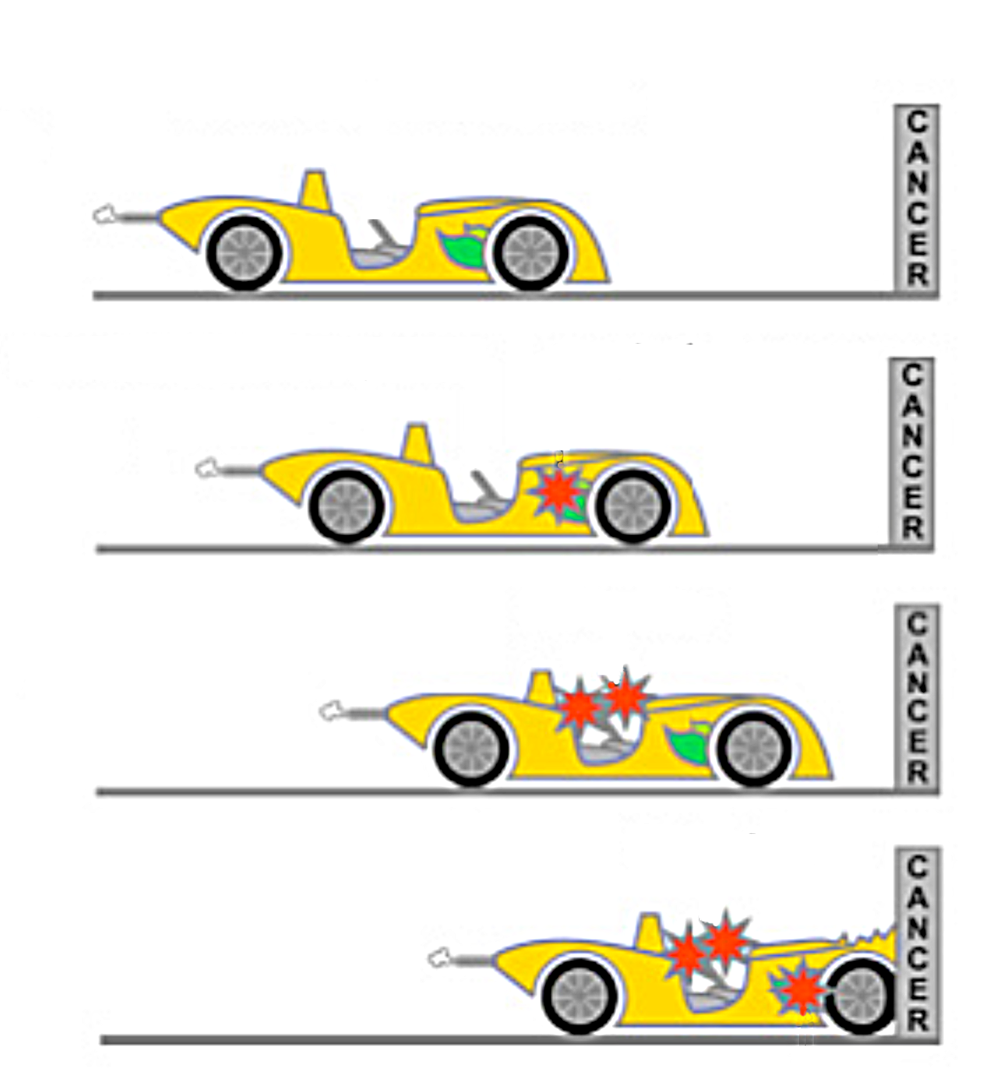
Which mutations are drivers?
A tumor cell has >10,000 mutations more than a normal cell.
Most are ‘passenger mutations’ that will have no effect on cell transformation.
‘Driver mutations’ occur in genes that affect survival, aging and proliferation. They drive the cell towards transformation

Slide 4
What order do driver mutations need to occur in?
Tumor
Tumor suppressor
Telomerase
Survival⬆⬆
Mutation 1
Mutation 2
Mutation 3
Proliferation ⬆⬆
Normal
cell
Aging
Aging
Oncogene

Slide 5
Which mutations could be drivers, and why?
Mutations
X

Slide 6
Which tumor will grow fastest?
Breast 1
Breast 2
Breast 3
Passenger
Driver (tumor suppressor)
Driver (telomerase)
Driver (oncogene)

Slide 7
How would you treat these tumors?
Breast 1
Breast 1
Breast 2
Breast 2
Breast 3
Breast 3
Passenger
Passenger
Driver
Driver

Slide 8
How would you treat these tumors?
Kidney
Lung
Breast 3
Passenger
Passenger
Driver
Driver

Slide 9
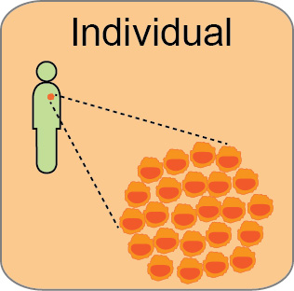
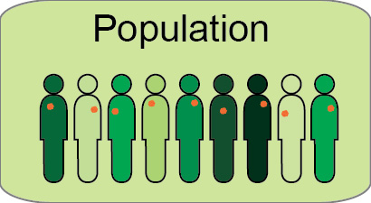
How can we personalize cancer treatment?
Each individual’s
cancer is different
But we treat them as though they’re all the same

Slide 10
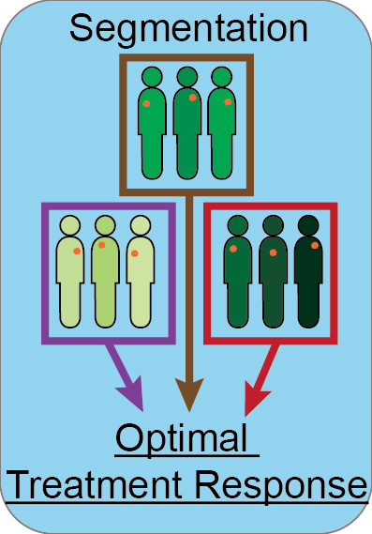
Dividing the population by tumor characteristics

Slide 11
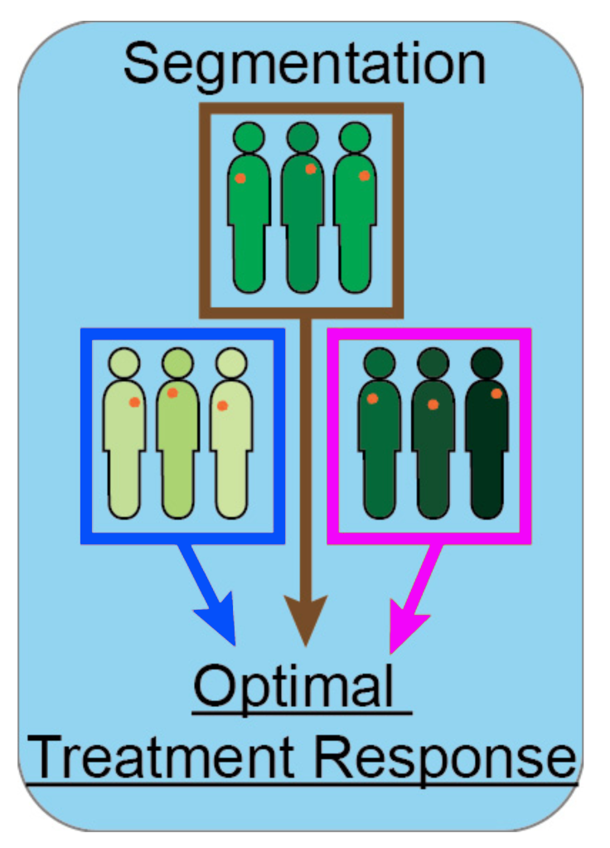
Segmenting the cohort by drivers

Slide 12
Activity
Driving cancer
Work in groups of three on interrupted case study to designing personalized treatment based upon efficacy of drugs tested by the Broad Institute.

Slide 13
Detecting DNA mutations
2003 Human Genome Project – 13 years, $3 billion
2007 Watson’s genome – 4 months, $1.5 million
Right now – 8 days, $5,000 - $10,000
Near future – 15 minutes, $1,000
What can it be used for?

Slide 14
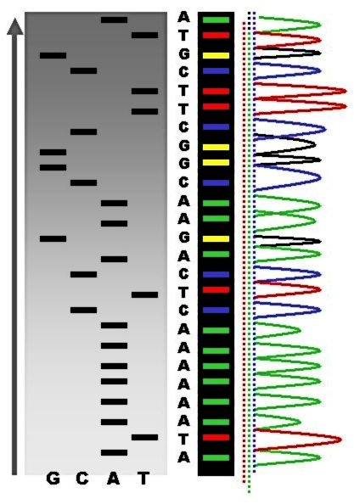
Somatic sequencing from tumors
DNA from the tumor cells is sequenced.
Identifies mutations are present in the tumor
Can be used for diagnosis or to identify a targeted drug treatment.

Slide 15
Germline sequencing from normal cells
DNA from cheek swab cells is sequenced.
Identifies mutations present in every cell.
If family members have the same mutations they are inherited

Slide 16
Germline mutations estimate risk
Prevalence: what proportion of the population has the mutation?
Penetrance: what proportion of people with mutation develop disease?

Slide 17
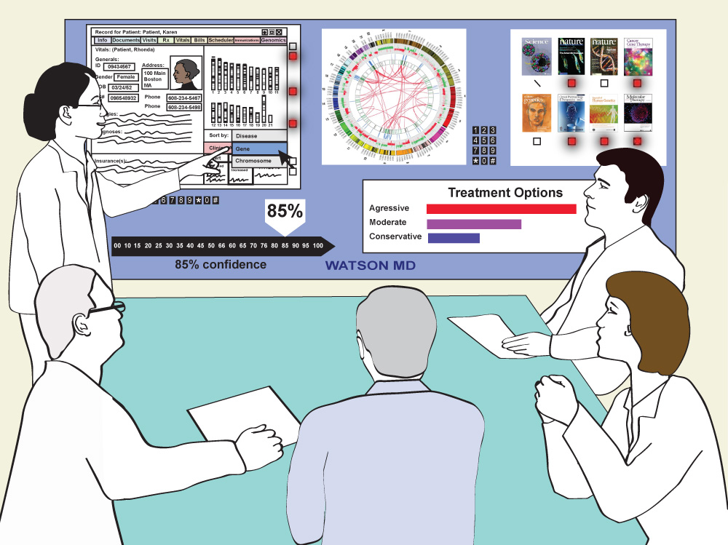
Wrap up

Slide 18
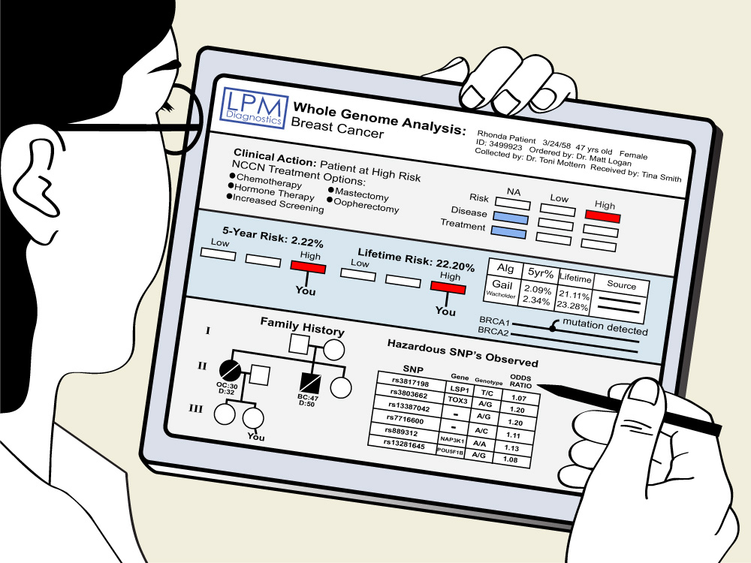
Wrap up

Slide 19
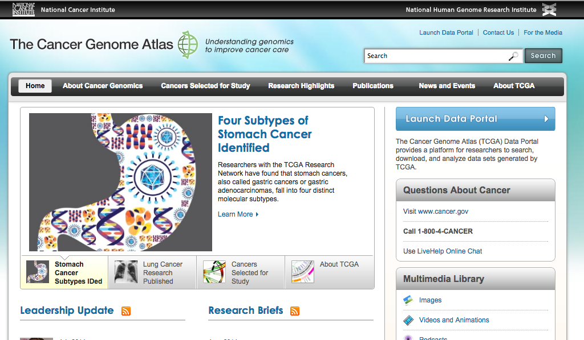
Wrap up

Slide 20
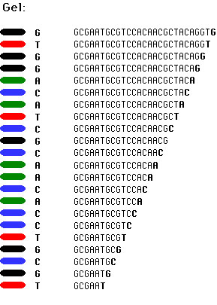
How DNA mutations are detected
Total length of the human genome – 3 billion base pairs

Slide 21
Homework
Read article on the Cancer Genome Atlas and answer questions to relate it to today’s class.
Gather information in preparation for the final discussion:
‘How would you like to see cancer research/treatment progress in the next 50 years?’

